Slide 1
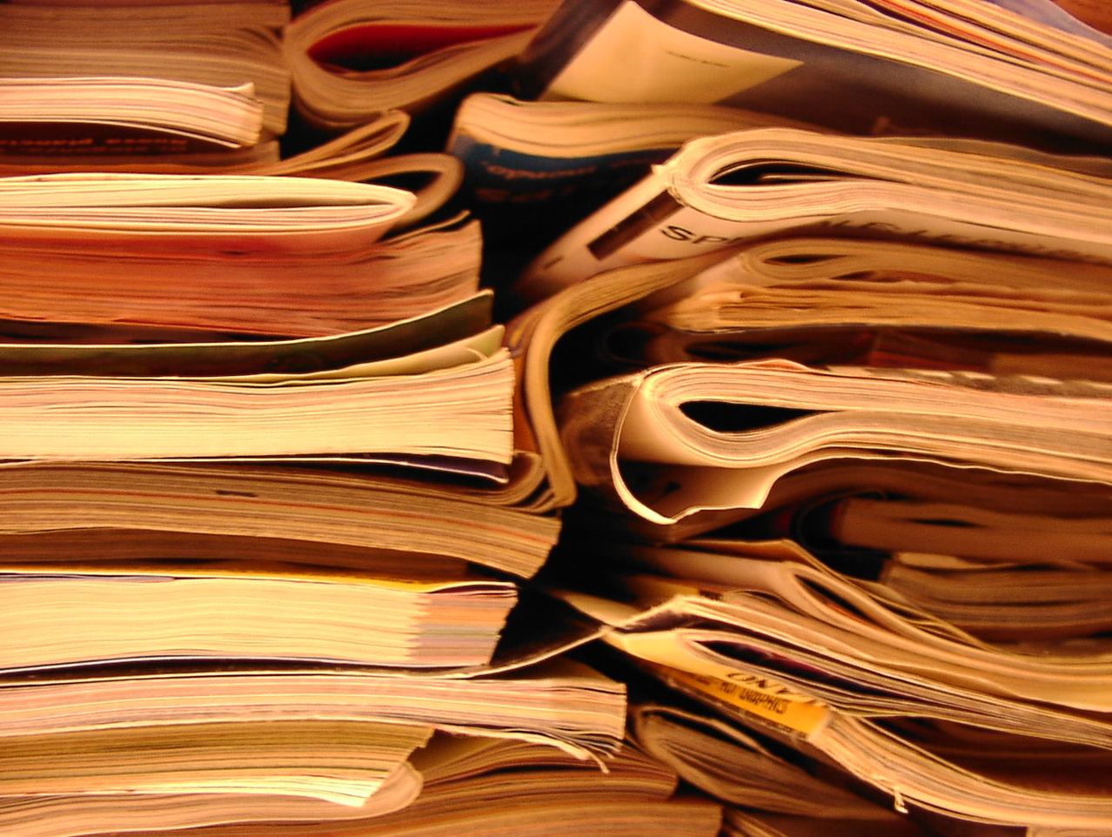
Open Scholarship Workshop Taylor Davis-Van Atta Digital Scholarship Coordinator, UH Libraries Publisher, Music & Literature: an arts and humanities journal tgdavisv@central.uh.edu November 16, 2018|Digital Research Commons
Notes:
The idea behind this session is to address some of the values and practices that are baked into the work that takes place in the DRC. This space is predicated on a belief that we, as researchers and librarians, should be adhering to good practice around open scholarship, i.e, whenever possible, using open source tools and software (rather that propriety versions, sharing our work at all stages of the process (whenever feasible and desirable), and, once a project or a phase of a project is complete, reporting out in a public way not only our findings and “finished products” but also our methods, our code, our process, etc., so that as many people as possible can benefit and build on our labor.

Slide 2
Agenda
A baseline for Open Access: its benefits, our objections, and how it disrupts the traditional publishing system
How to make existing journal publications openly available
Discussion about your research and publishing workflows: challenges to integrating open scholarly practices
Author addenda (what, when, and how) & publisher negotiations
Rights reversion and termination of transfer for published book chapters and monographs

Slide 3
“Humanities scholars study people and our histories and culture. What could be more important than that? Scholars produce amazing stuff and we should do what we can to help them reach a broad audience for their work. I frequently hear from independent scholars and scholars at less-resourced institutions. They tell me they can’t get ready access to the scholarship they need for their research. And interested members of the public are often unaware of scholarly books, articles, and other media. Most scholars I talk to are very enthusiastic about making their own work more widely available, but they’re not always sure how. So I think we should continue to strive for ways to make research outputs broadly accessible.”
–Brett Bobley, NEH Office of Digital Humanities
Notes:
How do we as researchers strive toward this ideal of open scholarship?
For projects hosted and funded by the DRC, we have adapted our expectations from those laid out by the National Endowment for the Humanities. NEH is a leader in promoting open scholarly practices so I thought we could start with this quote from their Office of Digital Humanities.
---
And from NEH Digital Project’s FAQ webpage:
“As a taxpayer-supported federal agency, NEH endeavors to make the products of its awards available to the broadest possible audience (including a project’s technologies, platforms, or approaches). Our goal is for scholars, educators, students, and the American public to have ready and easy access to the wide range of NEH award products.”
Not only should the finished products be made publicly available but also, to the extent possible, the code, methods, tools, and processes – all the fun stuff! – that were necessary components of making that product. All things being equal, NEH prefers to fund projects that use open source tools and platforms (as do we in the DRC). So if you build a new corpus for a text mining project that’s funded by the NEH, you make not only your findings accessible but also the corpus itself (to the extent that copyright allows) as well as the methods you used to arrive at your findings. All this then gives more value to the corpus and methods you built because it allows others out in the world to reproduce your findings and set new parameters on the corpus to run new mining experiments and produce yet more interesting outputs.
These practices and requirements all build toward a more inclusive, open, collaborative, and global scholarly environment.

Slide 4
What are the Advantages of Making Our Research Openly Available?
Impact
Making your work openly available means maximizing its potential to be read by anyone
Global Reach
Scholars (and others) all over the world can now read and engage with your work
Speed
Journal articles can take 18-24 months from submission to publication
Feedback
By offering access to early-stage work you can collect feedback & improve your work
Equity
Access is not limited to those who can afford it or who are affiliated with a wealthy institution
Utility
Other people can reuse or remix your work in new ways while providing you with proper attribution
Adapted from Nicky Agate’s “Open Humanities 101” presentation, delivered at FORCE 11 Scholarly Communication Institute, July 31, 2017.
Notes:
NEH and other funders have guidelines for authors/grantees that help meet their recommendations.
But many of us don’t have funding from NEH (or NSF or the Gates Foundation). We’re on our own. Maybe we have a list of publications that are behind paywalls, or maybe we’re just getting started in our careers and want to maximize the impact our future publications will have. So let’s talk about these finished products – our publications – that aren’t funded by one of these organizations.
So what are the advantages? And when we say “Openly Available” we’re talking about making our research products available online, with no paywall, for anybody who has an Internet connection to discover, access, and use according to an attached license. We can do this 1) by publishing with an Open Access journal or monograph publisher, or 2) by advocating for retention of our rights to make our research available online on our own through an OA online repository like Humanities Commons or the UH Institutional Repository. The first option – publishing with an OA journal – generally requires we pay an article processing fee, which can be quite expensive and might not be covered by a grant or by our academic department or university. The second option requires our time. Either way, we enjoy these same benefits.
Impact: several large-scale studies conducted over the past few years show increased citation and visibility impact when papers are made publicly available. Across nearly all disciplines, some at higher rates than others. Humanities: citation counts from articles published in OA journals roughly equal those of articles published in paywalled journals. But articles posted in OA repositories like Humanities Commons see a 165% increase in citations (see handout for full chart for details and citation).
Global reach: a lot of our research can have an impact in sectors outside of academia. Making our work available online, without that paywall restriction, allows that research to cross into other fields of study and reach readerships around the world.
Speed: especially important for graduate students who are hitting the job market and might need X number of publications in order to compete for an academic position. Around 80% of traditional journals allow for an early version of the manuscript or the peer-reviewed version of a paper to made available online, but there is usually an embargo on this right (as we’ll see later). A growing few allow for the peer-reviewed version of a paper to be posted online prior to publication of the final version, which is another way we can make our work immediately visible, without having to pay a fee – but typically the publisher states that early versions cannot appear online for anywhere from 6-48 months *after* publication.
Feedback: open peer review is a growing trend in the humanities and elsewhere. This is when researchers make early versions of their manuscripts available online for open comment and feedback prior to submission with a publisher. Good way, esp for early-career folks, to get their work out there, connect with others working in their intellectual arena, improve their work, gain some experience with the review process and integrating feedback, and bring some transparency to the review process.
Equity and Utility both go back to Brett Bobley’s quote. Even at the wealthiest institutions in the world, libraries aren’t able to offer sufficient subscription access to the world’s research. Much less those libraries at less well-off institutions. OA helps bridge a growing global access-to-research divide and accelerates knowledge production because we’re opening up more of the tools that go into producing research to more people worldwide.

Slide 5
What are the Objections to Making Our Research Openly Available?
I don’t have rights to my work
I don’t want to give away my copyright
My professors never did this—why should I?
Nobody will publish my work if I make it openly available first
Repositories are where content goes to die!
People can get access to anything through their library
I already put my stuff on ResearchGate—isn’t that enough?
People will steal my stuff or I’ll plagiarize/scoop myself
It’s too expensive!
Adapted from Nicky Agate’s “Open Humanities 101” presentation, delivered at FORCE 11 Scholarly Communication Institute, July 31, 2017.
Notes:
“I don’t have rights to my work.” –Copyright to a piece of research has been signed away to a publisher so there’s nothing I can do. I don’t have control over it. We’ll revisit this predicament a bit later.
“I don’t want to give away my copyright.” –When we’re talking about making your work available OA, at no time will you be asked to give away copyright. OA is about copyright retention and recovery, not giving it away.
“Professors” – OA as a generational push. Publisher policies and funder policies around OA have changed dramatically over the past 10-15 years, as the Internet has evolved to become a powerful agent of change in how scholarship is shared and disseminated. If you’re a student or early-career professional, you’re limiting yourself if you’re following the practices of an older generation.
“Nobody will publish…” – I hear this from students, especially, who are concerned that we’re going to make their dissertation openly available when they want to publish it as a monograph. This is a misconception about the publishing process. Making early versions of your work available is a net positive due to the visibility it gives you and your work. I’ve never heard of a publisher that has published a dissertation without significant structural and conceptual reworking. They want you to write to a specific audience. And I’ve never heard about a case where a publisher refused a manuscript because an earlier version of it was online. In any case, in the exceedingly rare case that a publisher raises this as an issue, you can simply remove earlier versions of your work from the web.
“Repositories…” – “Repositories” are a misnomer. Find the right one for your field, where people are active and reading and reviewing and discussing each other’s work. These are some of the most lively scholarly commons out there (Humanities Commons, etc.)
“People can get…” – We’ve addressed this one already.
“ResearchGate” – When scholars use ResearchGate or academia.edu, they are providing their data to a for-profit venture capital backed company who reserves the right to create derivatives of their intellectual property and leaves the researcher vulnerable to copyright violations and publisher takedown notices. Both sites need to turn a profit for their investors, and they’re doing it by selling information about you and leveraging your intellectual outputs. Further, these sites are not search engine optimized, nor do they comply with funder open access mandates; your work will be more visible and secure when it is deposited in a repository. In short, if you care about discoverability and retaining control over your research, social networking sites are not open access solutions.
“People will steal my stuff” – Prompt digital age discussion.
“It’s too expensive!” – Making your work OA is free UNLESS you choose to publish with an OA journal that requires a fee.

Slide 6
Who Owns It?
The copyright holder of a creative work controls all aspects of that work
The author is the copyright holder unless and until you transfer the copyright to someone else in a signed agreement
Assignment of these rights matters!
Transferring copyright doesn’t have to be all or nothing—and it shouldn’t be
Adapted from SPARC
Notes:
Some objections boil down to fairly simple foundations of Copyright Law as it pertains to scholarly works.
You control all aspects of a work and how it gets used and shared out in the world until such a time that you designate some or all of your rights over a work to someone else.
As a creator, you have the right to reproduce, distribute, transform, perform, display, reuse, and post your work wherever and however you’d like. You also have the right to license your work (declare how it may be legally used by others).
So I encourage people to keep this in mind from the beginning of their writing process. Be aware of all these things you can do with your work before you get to the publishing stage. And be aware, as you think about selecting a publisher, what that publisher’s rights policies are. Know which of these rights you want to retain…

Slide 7
As an author, you can lose the right to…
Reuse all or any part of your publication in future work
Reuse your data or other supplemental elements (images, charts, tables, graphs, etc.) in future work
Make your work available online
License your work
Distribute copies of your publication to your colleagues, peers, students, and prospective employers
Adapted from SPARC
Notes:
Retaining these rights is a big reason to consider publishing in an OA journal if you have the means to do so. But for the most part you can retain these rights by choosing a publisher that has copyright policies that align with your priorities and/or by negotiating with the publisher for a favorable rights retention packages.
The big question to my mind is: what life do you want your work to lead once it’s published? Do you want to be able to do some or all of the things listed here? What’s going to lead to the greatest impact for your work?
The answer to this question will inform the decisions you make around where to publish, your self-advocacy and negotiation plan.
So this is the question at the heart of open scholarly practice. What can this work that I’ve created do? How can it impact my area of study and the world at large, and how do I help it realize that impact?

Slide 8
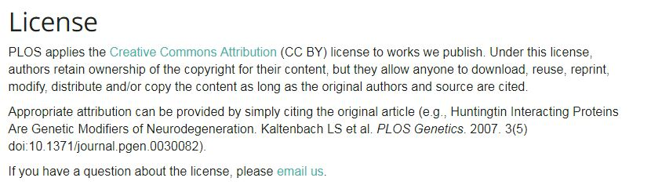
Public Library of Science (PLOS) Copyright Agreement
Notes:
This is an example of a copyright right agreement with an OA publication. In this case PLOS. It grants the author full retention of copyright and asks for only a non-exclusive license to publish the work openly. The license is legally binding and protects against acts of plagiarism or theft by others AND requires proper citation whenever someone uses your work in any way. So built into Open Access and open scholarship are these legally binding licenses that directly address those concerns around theft and unauthorized digital reproduction, etc.
You retain full rights over not only your finished product, but your data, figures, and any other byproducts you might have developed along the way. All the underlying stuff.
I think it’s helpful to see the legalese that OA is built upon. This language addresses in a really simple, elegant way those common objections we looked a few minutes ago.

Slide 9
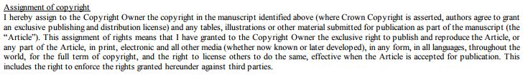

Elsevier Sample Copyright Agreement
https://www.elsevier.com/about/policies/copyright
Notes:
By contrast, this with the boilerplate copyright policy from Elsevier, which holds by far the world’s largest market share of research and scholarship.
Here the journal asks you to assign the full copyright of the article to Elsevier plus rights over your supplemental materials (figures, data, code, etc.) for the full copyright term (your lifetime + 70 years).

Slide 10
Under the Elsevier Agreement, Can You…
Reproduce your work in physical form? Options restricted to classroom use
Distribute those copies? Restricted to 50 or fewer copies to share with colleagues
Prepare transformative or other derivative works (e.g. translations)? Not without Elsevier’s permission
Perform or display the work publicly? Not without Elsevier’s permission
Reuse your work in teaching, future publications, and in all scholarly and professional activities? Options restricted (see above)
Post your work online? Only a pre-print (non-peer-reviewed) version—and only after applicable embargo period
License your work (declare how it may be legally used by others)? No.
Authorize others to exercise any of these rights? No.
Notes:
By signing a contract like this, without any negotiation, you severely limit your ability to exercise your rights over your research.
If we go back to the original list of rights you have under Copyright Law and compare them to what rights you are left with after signing such an agreement, we see how little control we’re left with.

Slide 11

What are the Advantages of Making Our Research Openly Available?
Impact
Making your work openly available means maximizing its potential to be read by anyone
Global Reach
Scholars (and others) all over the world can now read and engage with your work
Speed
Journal articles can take 18-24 months from submission to publication
Feedback
By offering access to early-stage work you can collect feedback & improve your work
Equity
Access is not limited to those who can afford it or who are affiliated with a wealthy institution
Utility
Other people can reuse or remix your work in new ways while providing you with proper attribution
Adapted from Nicky Agate’s “Open Humanities 101” presentation, delivered at FORCE 11 Scholarly Communication Institute, July 31, 2017.
Notes:
And if we go back to the advantages page, we see how all this translates.
What’s the broader picture here? Basically, what Elsevier and other major publishers are doing is controlling researchers’ publishing and sharing expectations. They are investing in “end-to-end solutions” for researchers – they are building proprietary tools and platforms and academic social networking sites that make the researcher’s publishing experience as seamless and convenient as possible. They’re willing to make these big investments because if we get comfortable using their tools and their peer review systems and their sharing networks, then we’ll continue publishing with them and we’ll continue giving them huge market shares of research that we produced without compensation and feel forced to hand the rights to it over to them for free. These policies and copyright transfer agreements are the heart of their business model, and as we continually agree to them they’re able to extract monetary gain our of our intellectual property, which we then have limited control over.

Slide 12
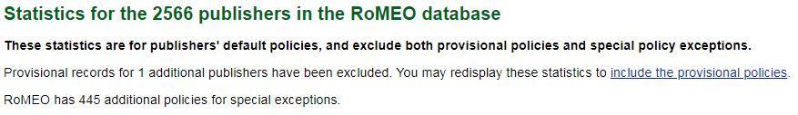
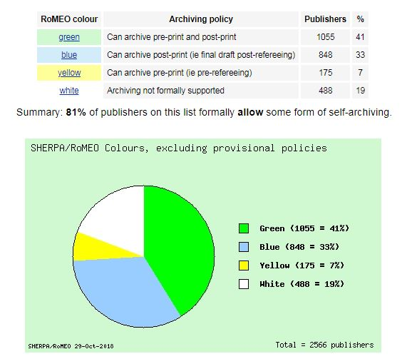
http://www.sherpa.ac.uk/romeo/index.php
Notes:
How do we disrupt the system?
First, for existing publications we can use a handy tool called Sherpa/Romeo. Who has used this before?
Sherpa/Romeo is a public database that collects and maintains the copyright and OA policies of journals from around the English-speaking world.
Navigate to this URL and type in the name of the last journal you published with, or a recent journal. And let’s talk about what you find.
Color
Pre-print
Post-print
Embargos
Other terms and conditions
81% of all publishers collected in Sherpa allow for some version of an article to appear online publically. About 33% allow for a post-print (or peer-reviewed version) to appear online.

Slide 13
“Most of the time, you may lawfully make your work Open Access through a repository even if you published in a non-OA journal.
There are two reasons why:
First, most non-OA publishers give standing permission for green OA
Second, research institutional can adopt policies to assure permission for green OA even in cases where publishers don’t already give standing permission.”
—Peter Suber, Harvard Open Access Project
Notes:
You can consult Sherpa about most journals that publish in English. Key to pay attention to 1) version that you can make available and 2) embargo policy, which tells you when you can make that version available.

Slide 14
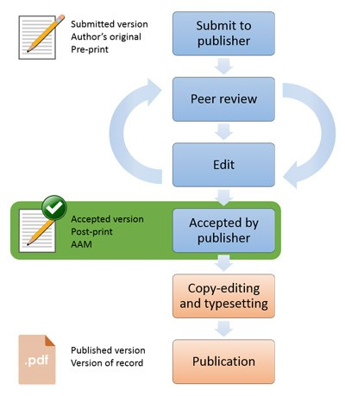
Notes:
Handy graphic that illustrates what is meant by “pre-print” and “post-print” and “version of record”
Discuss workflows:
Keeping all this in mind, what challenges do you see in making your existing journal publications available OA? And what practices could you adopt that would help overcome those barriers?
One practice I can think of is to keep track of your versions of publications so you can easily find them when the time comes to make it available. Record keeping and tracking when new papers, if they’re paywalled, are eligible to be released publicly.
(Are you required to use publisher portal for peer review? Do you have access to those earlier versions?)

Slide 15
“Gold” OA: Objections from the Humanist
There are no OA journals in the humanities
OA journals are predatory
Publishing in an OA journal won’t count for tenure
OA journals are less prestigious
I can’t pay that huge Article Processing Charge!
OA journals aren’t peer reviewed
Adapted from Nicky Agate’s “Open Humanities 101” presentation, delivered at FORCE 11 Scholarly Communication Institute, July 31, 2017.
Notes:
Counterpoints:
Check a tool called “Directory of Open Access Journals” for OA journals in any discipline, including the humanities. There are top-ranked journals in the majority of fields that are OA.
Predatory pub discussion and vetting OA pubs.
Harder to convince T&P committees (or hiring committees, if you’re trying to break into academia) of the prestige of OA publications because they have no proof of prestige: they have not heard of these journals, they might not even know what OA is. In other words, to them, OA publishing possesses none of the intangible prestige that makes humanities publishing work. This is a generational challenge.
Less prestigious – see DOAJ, etc, for comparative metrics
APC – if it’s not covered by university or by your home department or by a grant, it’s out of pocket
They are, which is why their timetable and standards around peer review should be made transparent on their journal websites

Slide 16
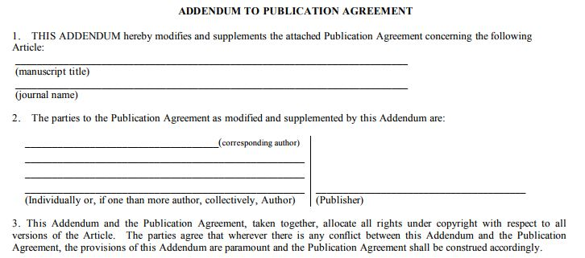
Author Addenda
Accessed January 30, 2018 from https://sparcopen.org/our-work/author-rights/brochure-html/
Notes:
Supposing we don’t find a suitable OA journal or we can’t afford the APC. What can we do?

Slide 17
A Balanced Approach to Rights Might Look Like…
The Author retains the right to…
use and develop her/his own work without restriction
increase circulation of the work for education and research purposes
receive proper attribution when the work is used
deposit the work in an online open access repository where it will be forever available, if desired
The Publisher is granted the right to…
a non-exclusive license to publish and distribute work
receive proper attribution and citation as journal of first publication
migrate the work to future formats and include it in collections, indexes, and databases
receive a financial return
Adapted from SPARC’s “Author Rights: Using the SPARC Author Addendum. Accessed Feb 5, 2018, from https://sparcopen.org/our-work/author-rights/brochure-html/

Slide 18
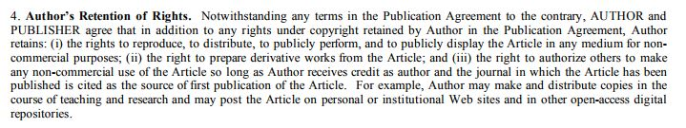
Notes:
This clause states…
Process for submitting addendum to a publisher

Slide 19
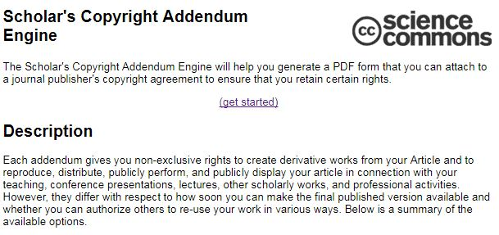
Notes:
Also on your handout is a link to the Scholar’s Copyright Addendum Engine, which walks you through the process of creating your own, customized addendum. This is more STEM-oriented, but it’s good to get a sense for a range of addenda that are out there.
MIT, Harvard, and others have also created their own recommended addenda for their researchers to use, that’s customized to their particular institutional policies around OA. If/when UH passes OA policy or guidelines for its researchers, we’ll draft one of these as well.

Slide 20
If the Publisher Objects to an Addendum…
Explain the importance for you to retain these rights (be specific)
Ask the publisher to articulate why the license rights provided under the author addendum are insufficient to allow publication
Evaluate the adequacy of the publisher’s response in light of the reasonable and growing need for authors to retain key rights
Consider publishing with an organization that will facilitate the widest dissemination of your work
Still no? Publish your work as planned and reconsider next time – the decision is up to you.
Adapted from SPARC’s “Author Rights: Using the SPARC Author Addendum. Accessed Feb 5, 2018, from https://sparcopen.org/our-work/author-rights/brochure-html/
Notes:
This can and should be a back and forth discussion.
Remember that they’ve made an investment in you and your work. They want to publish it. They’ve devoted resources around peer review and editors’ time.

Slide 21
Rights Reversion
Renegotiation of a contract/agreement that may allow an author to regain some or all rights to her book from the publisher when certain conditions are met
“Triggering conditions,” such as out-of-print clause or a clause specifying a minimum threshold in sales numbers – clauses written into original agreement
No “reversion” clause necessary in the original agreement; there’s nothing saying you can’t revisit a given contract
Why might you want to pursue reversion?
Write an updated edition
Re-release in a more affordable format
Reproduce as an open edition, digital edition, or as an open educational resource (OER)
Read the contract (or request it from your publisher)
Consultation on individual case basis

Slide 22
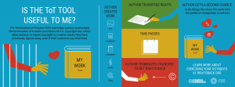
Termination of Transfer
https://rightsback.org/

Slide 23
Thanks!
Questions or schedule a consultation…
Taylor Davis-Van Atta
tgdavisv@central.uh.edu

